Slide 1
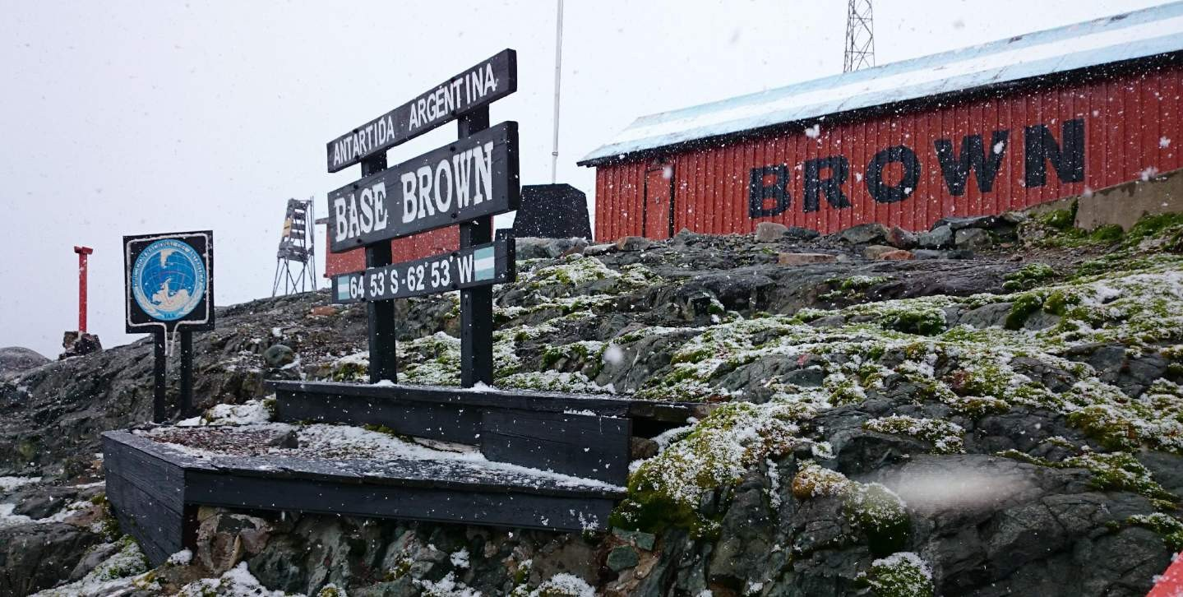
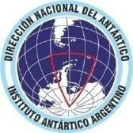
WELCOME TO BROWN STATION
ARGENTINE ANTARCTIC PROGRAM

Slide 2
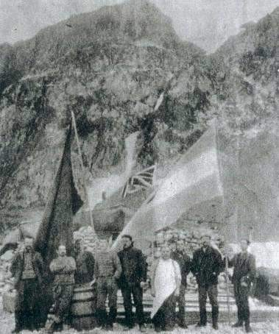
ARGENTINE PRESENCE IN ANTARCTICA
1904 – 2017
UNINTERRUPTED ARGENTINE PRESENCE
Orcadas Station (South Orkney Islands)
The oldest permanent station in Antarctica

Slide 3
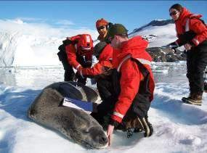
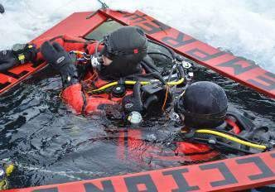
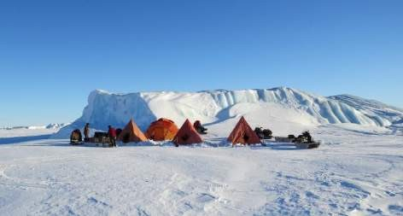
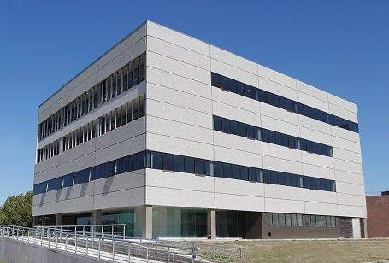
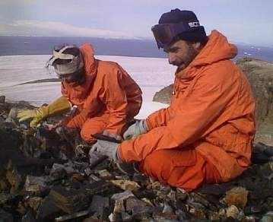
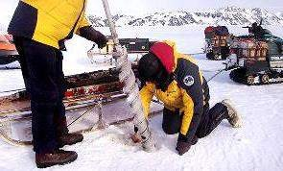
ARGENTINE PRESENCE IN ANTARCTICA
Instituto Antártico Argentino (IAA)
- 1951 -
IAA
The first institute in the world
exclusively dedicated to Antarctic research

Slide 4
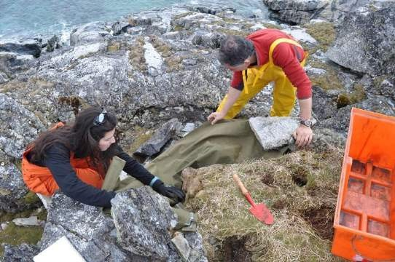
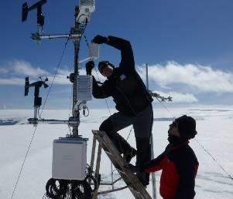
ARGENTINE PRESENCE IN ANTARCTICA
50 Science projects anually
Over 200 researchers deployed in Antarctica each austral summer season
Over 50% of science projects in international cooperation (Germany, Spain, Chile, Italy, Brazil, Peru, Australia)

Slide 5
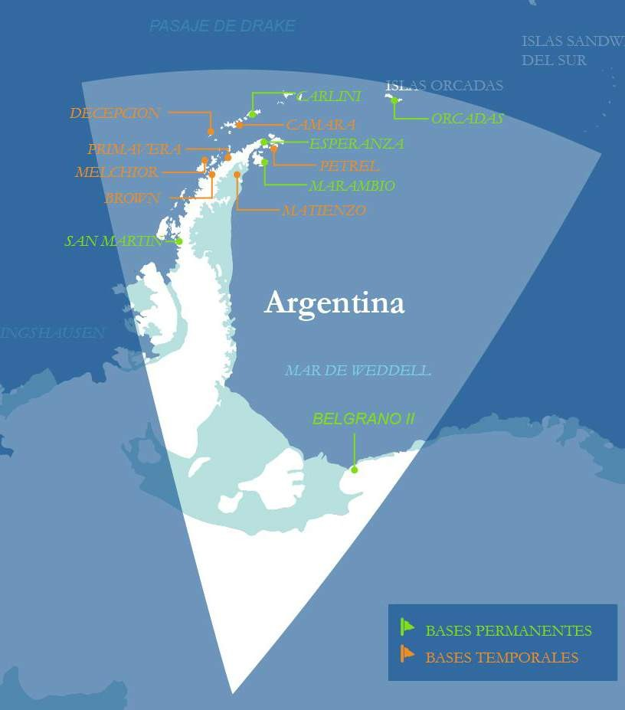
ARGENTINE PRESENCE IN ANTARCTICA
13 Argentine Stations
7 year-round
6 summer only
PEACE SCIENCE
ENVIRONMENTAL PROTECTION COOPERATION
BROWN STATION

Slide 6
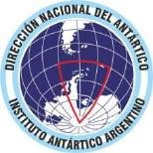
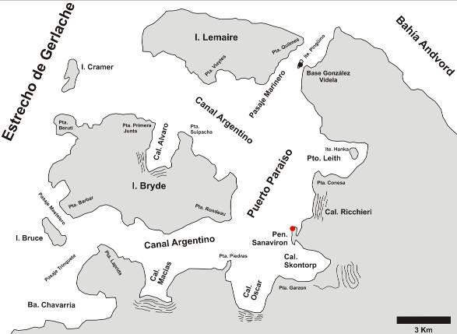
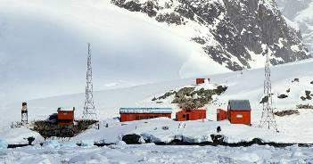
BROWN STATION: LOCATION
Managed by:
Dirección Nacional del Antártico
Instituto Antártico Argentino
On the west side of the Antarctic Peninsula, on the Gerlache Strait, at the north end of the Sanaviron Peninsula

Slide 7
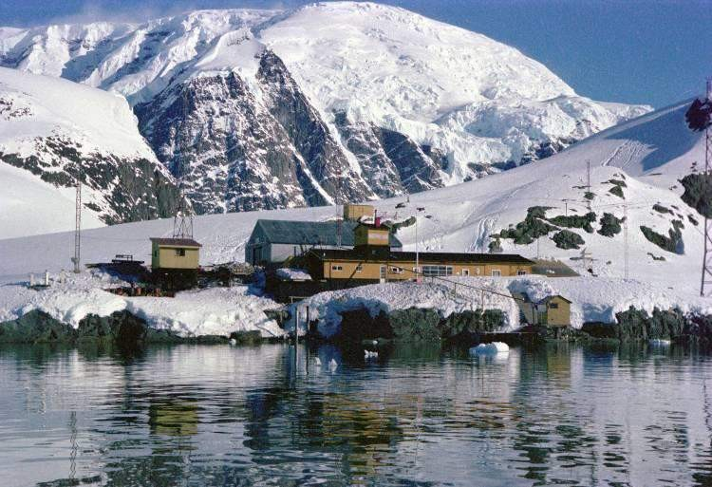
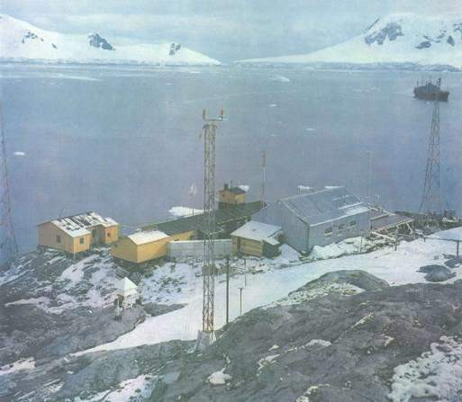
BROWN STATION: HISTORY
1951-1960
Almirante Brown (Admiral Brown) Naval Detachment
Meteorological observatory and logistical support for scientific projects

Slide 8
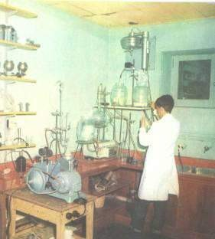
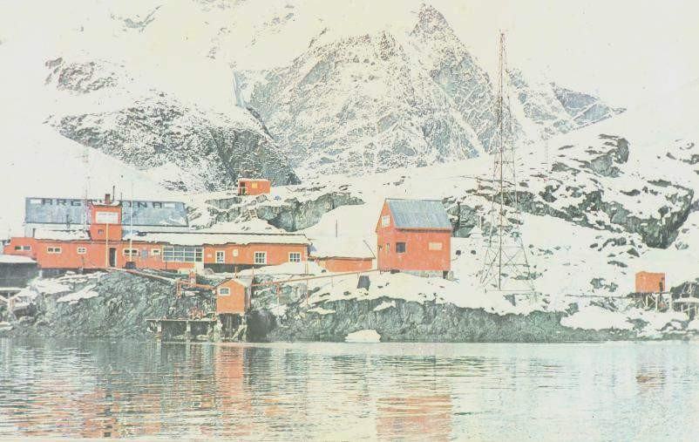
BROWN STATION: HISTORY
1964/1965
Complete refurbishment of Naval Detachment
One of the better equipped biology laboratories in the Antarctic Peninsula
Almirante Brown Scientific Station (IAA)

Slide 9
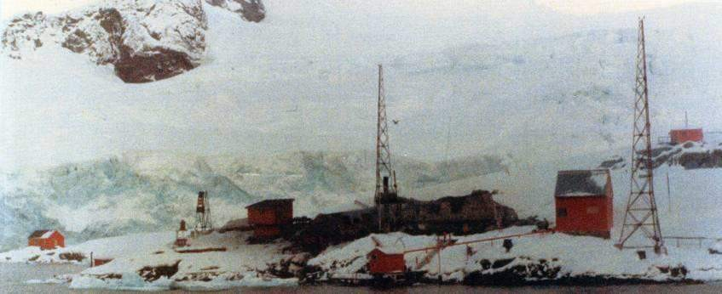
BROWN STATION: HISTORY
1984
Part of main facilities destroyed
Station fire

Slide 10
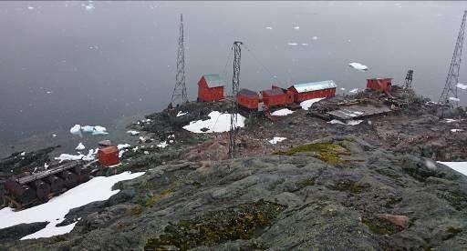
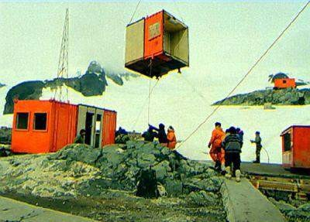
BROWN STATION: HISTORY
1995/1996
Station rebuilding
Diverse scientific activities during summer season

Slide 11
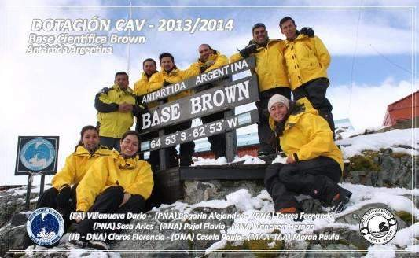
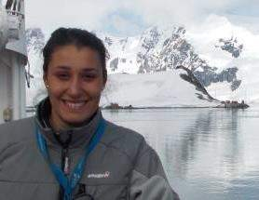
BROWN STATION: HISTORY
2013/2014
First female Station Leader
Station Leader Florencia Claros

Slide 12
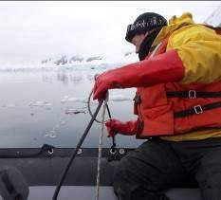
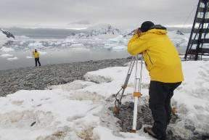
BROWN STATION: SCIENCE
Census of penguins, flying birds, cetaceans and leopard seals.
Oceanographic studies.
Geological / geomorphical research. Monitoring of penguin population trends.

Slide 13
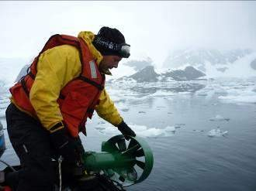
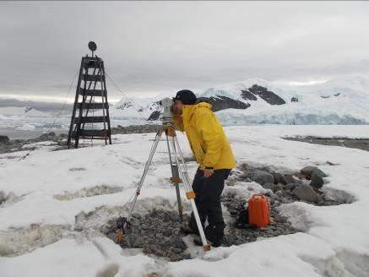
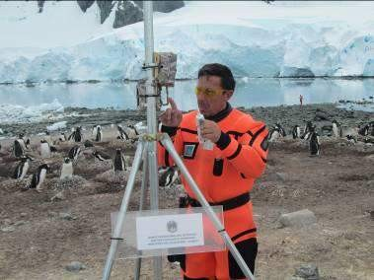
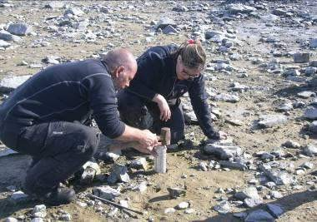
BROWN STATION: SCIENCE

Slide 14
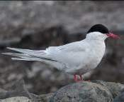
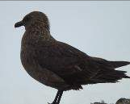
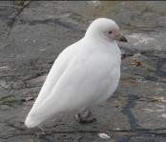
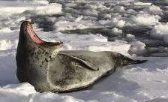
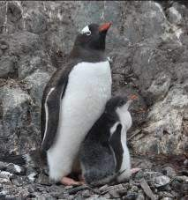
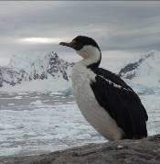
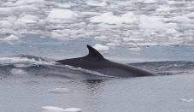
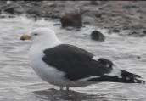
BROWN STATION: FAUNA
Antarctic tern
South polar skua
Leopard seal
Snowy sheathbill
Minke whale
Gentoo penguin
Kelp gull
Antarctic shag
Leopard Seal photo: Grupo “Antártida Profunda”

Slide 15
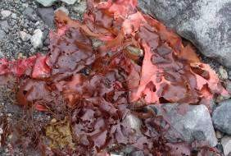
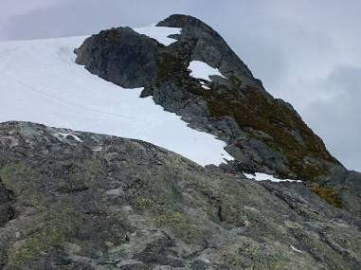
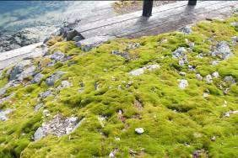
BROWN STATION: FLORA
Algae / seaweed
Grasses
Mosses

Slide 16
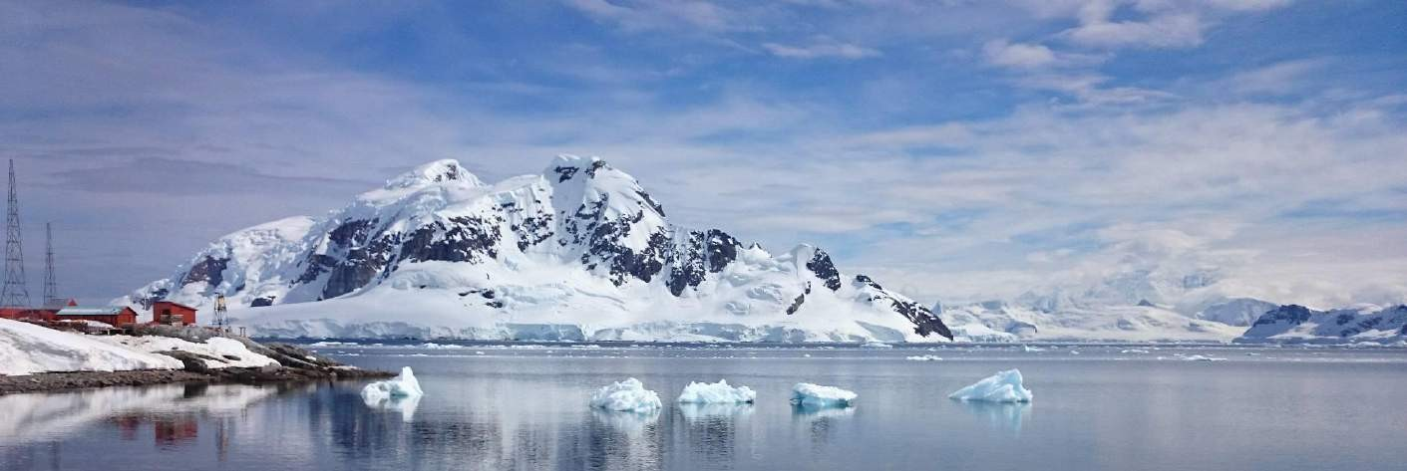
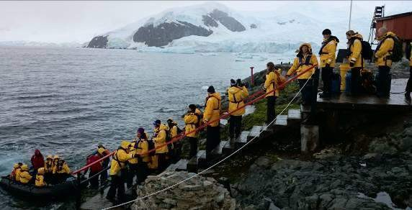
BROWN STATION: ENVIRONMENTAL PROTECTION AND
TOURISM REGULATION
Outstanding
natural beauty
Visitors must respect all the environmental protection rules
Brown Station / Paradise Bay
One of the 10 most visited sites by tourism in Antarctica

Slide 17




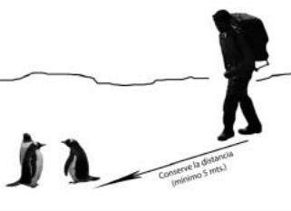
BROWN STATION: ENVIRONMENTAL PROTECTION AND
TOURISM REGULATION
Careful consideration of all Antarctic Treaty and Environmental
Protocol regulations.
Three big DO NOTs Do not come close to the
fauna, OR feed animals. Keep a precautionary minimum distance of 5 meters and allow animals to move freely. Keep a longer distance if animals´ behavior changes.
Do not damage plants by walking on vegetation
Reproduction = most sensitive period
Do not leave any litter (take it
with you!)

Slide 18
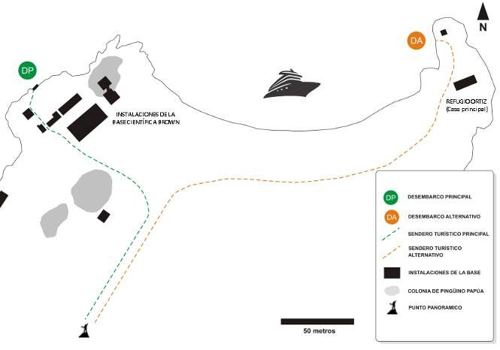
BROWN STATION: STATION GUIDELINES FOR VISITORS
Minimize environmental impact
Specific regulations for visits
MANDATORY
For everyone intending to land at Brown Station.

Slide 19
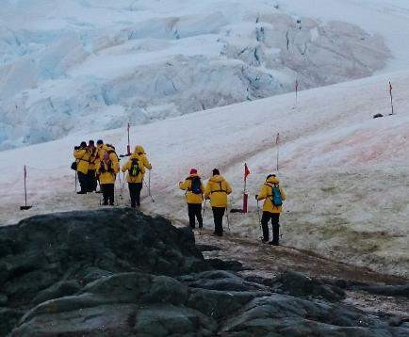
BROWN STATION: STATION GUIDELINES FOR VISITORS
Behaviour code
Walk only within authorized tracks. For better orientation, tracks are marked by small flags/pennants.
Hiking towards the panoramic viewpoint shall only be in small groups.
Walk slowly and carefully.

Slide 20
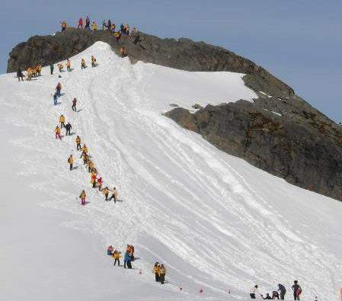
BROWN STATION: STATION GUIDELINES FOR VISITORS
Behaviour code
Do not separate from the group. Follow advice and instructions by the guides and the Station’s personnel.
Do not enter the facilities, unless authorized by the Station’s personnel.
Do not interfere with the Station’s activities and respect the privacy of the Station’s personnel.

Slide 21
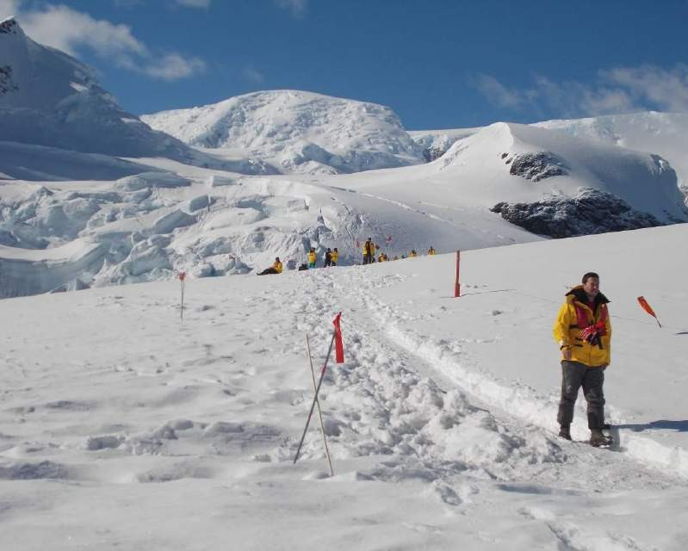
BROWN STATION: STATION GUIDELINES FOR VISITORS
Behaviour code
Precautionary
remarks
Be extremely careful when going up and moving around the viewpoint, as there may
be cracks in the ice.
Not more than 20 people at a time on top of the panoramic viewpoint.

Slide 22

Thank you for your attention
BE SAFE - ENJOY YOUR STAY
Station personnel can assist you

Slide 23

FOR FURTHER INFORMATION
DIRECCIÓN NACIONAL DEL ANTÁRTICO
Programa de Gestión Ambiental y Turismo
(Environmental Management and Tourism Program)
Balcarce 290, Ciudad Autónoma de Buenos Aires,
Argentina
TE: (+54-11) 4331-2900 int 217
ambiente@dna.gov.ar

